Slide 1




Slide 2
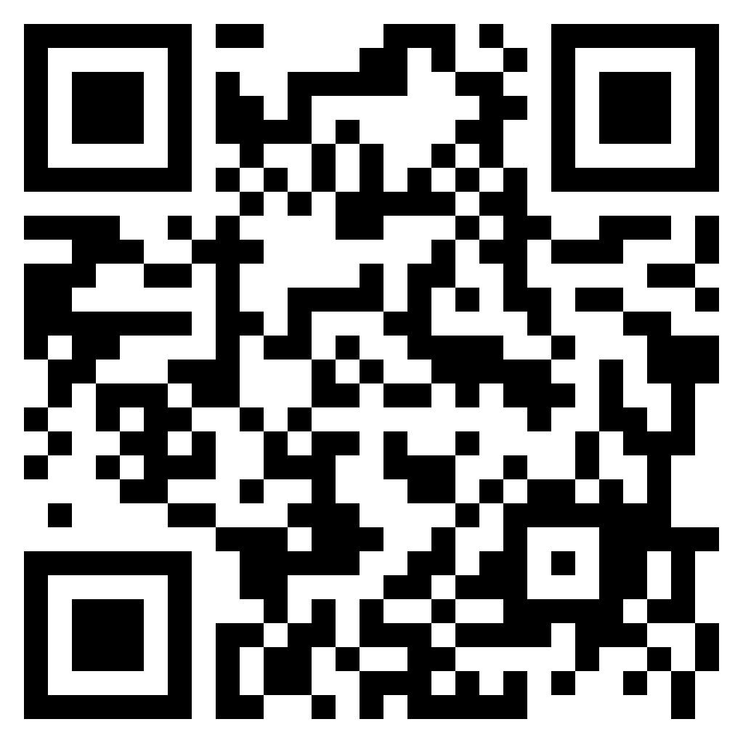
URL: https://forms.gle/5fzx9ZYV6YzTk5eQ7
QR CODE:
TEST TIME ON PUNCTUATION :

Slide 3
Verbal Reasoning
Verbal Reasoning

Slide 4
Verbal Reasoning
Each question given below consists of a statement, followed by two arguments numbered I and II. You have to decide which of the arguments is a 'strong' argument and which is a 'weak' argument.
Give answer:
(A) If only argument I is strong
(B) If only argument II is strong
(C) If neither I nor II is strong and
(D) If both I and II are strong.

Slide 5
Question: 01
Statement: Should India encourage exports, when most things are insufficient for internal use itself?
Arguments:
I. Yes. We have to earn foreign exchange to pay for our imports.
II. No. Even selective encouragement would lead to shortages.
If only argument I is strong
If only argument II is strong
If neither I nor II is strong
If both I and II are strong
Answer: A

Slide 6
Explanation:
Answer: Option A
Clearly, India can export only the surplus and that which can be saved after fulfilling its own needs, to pay for its imports. Encouragement to export cannot lead to shortages as it shall provide the resources for imports. So, only argument I holds.

Slide 7
Question: 02
Statement: Should all the drugs patented and manufactured in Western countries be first tried out on sample basis before giving licence for sale to general public in India?
Arguments:
I. Yes. Many such drugs require different doses and duration for Indian population and hence it is necessary.
II. No. This is just not feasible and hence cannot be implemented.
If only argument I is strong
If only argument II is strong
If neither I nor II is strong
If both I and II are strong
Answer: A

Slide 8
Explanation:
Answer: Option A
Clearly, health of the citizens is an issue of major concern for the Government. So, a product like drugs, must be first studied and tested in the Indian context before giving licence for its sale. So, only argument I holds strong.

Slide 9
Question: 03
Statement: Should India make efforts to harness solar energy to fulfil its energy requirements?
Arguments:
I. Yes, Most of the energy sources used at present is exhaustible.
II. No. Harnessing solar energy requires a lot of capital, which India lacks in.
If only argument I is strong
If only argument II is strong
If neither I nor II is strong
If both I and II are strong
Answer: A

Slide 10
Explanation:
Answer: Option A
Clearly, harnessing solar energy will be helpful as it is an inexhaustible resource unlike other resources. So, argument I holds. But argument II is vague as solar energy is the cheapest form of energy.

Slide 11
Question: 04
Statement: Should there be students union in college/university?
Arguments:
I. No. This will create a political atmosphere in the campus.
II. Yes, it is very necessary Students are future political leaders.
If only argument I is strong
If only argument II is strong
If neither I nor II is strong
If both I and II are strong
Answer: D

Slide 12
Explanation:
The students union formation shall be a step towards giving to students the basic education in the field of politics. However, it shall create the same political atmosphere in the campus. Thus, both the arguments hold strong.

Slide 13
Question: 05
Statement: Should cottage industries be encouraged in rural areas?
Arguments:
I. Yes. Rural people are creative.
II. Yes. This would help to solve the problem of unemployment to some extent..
If only argument I is strong
If only argument II is strong
If neither I nor II is strong
If both I and II are strong
Answer: B

Slide 14
Explanation:
Answer: Option B
Clearly, cottage industries need to be promoted to create more job opportunities for rural people in the villages themselves. The reason that rural people are creative is vague. So, only argument II holds.

Slide 15
Question: 06
Statement: Should young entrepreneurs be encouraged?
Arguments:
I. Yes. They will help in industrial development of the country.
II. Yes. They will reduce the burden on employment market.
If only argument I is strong
If only argument II is strong
If neither I nor II is strong
If both I and II are strong
Answer: D

Slide 16
Explanation:
Answer: Option D
Clearly, encouraging the young entrepreneurs will open up the field for the establishment of new industries. Thus, it shall help in industrial development and not only employ the entrepreneurs but create more job opportunities for others as well. So, both the arguments hold strong.

Slide 17
Question: 07
Statement: Should all the annual examinations up to Std. V be abolished?
Arguments:
I. Yes. The young students should not be burdened with such examinations which hampers their natural growth.
II. No. The students will not study seriously as they will get automatic promotion to the next class and this will affect them in future.
If only argument I is strong
If only argument II is strong
If neither I nor II is strong
If both I and II are strong
Answer: D

Slide 18
Explanation:
Answer: Option D
Clearly, neither the students can be burdened with studies at such a tender age, nor can they be left free to take studies casually, as this shall weaken their basic foundation. So, both the arguments follow.

Slide 19
Question: 08
Statement: Should Indian scientists working abroad be called back to India?
Arguments:
I. Yes. They must serve the motherland first and forget about discoveries, honours, facilities and all.
II. No. We have enough talent; let them stay where they want.
If only argument I is strong
If only argument II is strong
If neither I nor II is strong
If both I and II are strong
Answer: C

Slide 20
Explanation:
Answer: Option C
Clearly, every person must be free to work wherever he wants and no compulsion should be made to confine one to one's own country. So, argument I is vague. However, talented scientists can be of great benefit to the nation and some alternatives as special incentives or better prospects may be made available to them to retain them within their motherland. So, argument II also does not hold.

Slide 21
Question: 09
Statement: Should we scrap the system of formal education beyond graduation?
Arguments:
I. Yes. It will mean taking employment at an early date.
II. No. It will mean lack of depth of knowledge.
If only argument I is strong
If only argument II is strong
If neither I nor II is strong
If both I and II are strong
Answer: B

Slide 22
Explanation:
Answer: Option B
Clearly, argument I is vague because at present too, many fields are open to all after graduation. However, eliminating the post-graduate courses would abolish higher and specialized studies which lead to understanding things better and deeply. So, argument II is valid.

Slide 23
Question: 10
Statement: Should there be an upper age limit of 65 years for contesting Parliamentary/ Legislative Assembly elections?
Arguments:
I. Yes. Generally, people above the age of 65 lose their dynamism and will power.
II. No. The life span is so increased that people remain physically and mentally active even up to the age of 80.
If only argument I is strong
If only argument II is strong
If neither I nor II is strong
If both I and II are strong
Answer: C

Slide 24
Explanation:
Answer: Option C
The age of a person is no criterion for judging his mental capabilities and administrative qualities. So, none of the arguments holds strong.

Slide 25
Passage
Read the passage and answer the question based on it.
A fact that draws our attention is that, according to his position in life, an extravagant man is either admired or loathed. A successful business man does nothing to increase his popularity by being prudent with his money. A person who is wealthy is expected to lead a luxurious life and to be lavish with his hospitality. If he is not so, he is considered mean, and his reputation in business may even suffer in consequence. The paradox remains that he had not been careful with his money in the first place; he would never have achieved his present wealth.

Slide 26
Among the low income group, a different set of values exists. The young clerk, who makes his wife a present of a new dress when he has not paid his house rent, is condemned as extravagant.Carefulness with money to the point of meanness is applauded as a virtue. Nothing in his life is considered more worthy than paying his bills. The ideal wife for such a man separates her housekeeping money into joyless little piles – so much for rent, for food, for the children’s shoes, she is able to face the milkman with equanimity every, month satisfied with her economizing ways , and never knows the guilt of buying something she can’t really afford .
As for myself, I fall neither of these categories. If I have money to spare I can be extravagant, but when, as is usually the case, I am hard up and then I am the meanest man imaginable.

Slide 27
Question: 11
Which of the following would be the most appropriate title for the passage:
Being extravagant is always condemnable.
The cause of poverty is extravagance.
Extravagance is a part of the rich as well as of the poor.
Stingy habits of the poor.
Answer: C

Slide 28
Explanation:
Answer: Option C
This is the most appropriate title as the author sheds light on the life of a rich person in the first paragraph and discusses the life of a person who belongs to lower strata of the society in the second paragraph.

Slide 29
Question: 12
According to the passage the person, who is a successful businessman and wealthy
Is expected to have lavish lifestyle.
Should not bother about popularity.
Is more popular if he appears to be wasting away his time.
Must be extravagant before achieving success.
Answer: A

Slide 30
Explanation:
Answer: Option A
It is given in the fourth line of the 1st paragraph.:“If he .........consequence.”

Slide 31
Question: 13
The phrase ‘lavish with his hospitality’ in the third sentence of the first paragraph means
Thoughtful in spending only on guests and strangers.
Unconcerned in treating his friends and relatives.
Stinginess in dealing with his relatives.
Extravagance in entertaining guest.
Answer: D

Slide 32
Explanation:
Answer: Option D
The meaning of the word “hospitality” is the quality or disposition of receiving and treating guests and strangers in a warm, friendly, generous way which justifies that option d is the correct answer choice.

Slide 33
Question: 14
The word ‘paradox’ in the last sentence of the first paragraph means
Statement based on the popular opinion
a statement that seems self-contradictory but in reality expresses a possible truth.
Statement based on facts
A word that brings out the hidden meaning
Answer: B

Slide 34
Explanation:
Answer: Option B
The meaning of the word “paradox” is given in option B and it is also explained in the last sentence of the first paragraph.

Slide 35
Question: 15
What is the meaning of the word “equanimity”?
Calmness
Discomposure
Equivocal
Dubious
Answer: A

Slide 36
Explanation:
Answer: Option A
The word “equanimity” means mental or emotional stability or composure, especially under tension or strain as can further be understood as in this example “Raj was a man of great equanimity, even when talking about his own death.”

